Slide 1



Build Web Apps with ASP.NET Core and C# for Beginners
Version: 3.0
Trainer: CK Leng
Course Code: C213
Website:www.tertiarycourses.com.my
Email: sales@tertiarycourses.com.my
This material belongs to Tertiary Infotech Pte Ltd (UEN: 201200696W). All Rights Reserved.
Notes:
https://learn.microsoft.com/en-us/training/paths/aspnet-core-web-app/

Slide 2
About the Trainer
‹#›

Slide 3


Slide 4
Ground Rules
Set your mobile phone to silent mode
Actively participate in the class. No question is stupid.
Respect each other view
Exit the class silently if you need to step out for phone call, toilet break

Slide 5

Ground Rules for Virtual Training
Upon entering, mute your mic and turn on the video. Use a headset if you can
Use the 'raise hand' function to indicate when you want to speak
Participant actively. Feel free to ask questions on the chat whenever.
Facilitators can use breakout rooms for private sessions.

Slide 6
Guidelines for Facilitators
Once all the participants are in and introduce themselves
Goto gallery mode, take a snapshot of the class photo - makes sure capture the date and time
Start the video recording (only for WSQ courses)
Continue the class
Before the class end on that day, take another snapshot of the class photo - makes sure capture the date and time
For NRIC verification, facilitator to create breakout room for individual participant to check (only for WSQ courses)
Before the assessment start, take another snapshot of the class photo - makes sure capture the date and time (only for WSQ courses)
For Oral Questioning assessment, facilitator to create breakout room for individual participant to OQ (only for WSQ courses)
End the video recording and upload to cloud (only for WSQ courses)
Assessor to send all the assessment records, assessment plan and photo and video to the staff (only for WSQ courses).

Slide 7
Prerequisite
This is a beginner course. No prerequisites.

Slide 8
Agenda
Topic 1 Write your first C# code
Write your first code
Learn how it works
Complete the challenge
Review the solution
Topic 2 Get started with web development using Visual Studio Code
Set up the structure of your web app
Add basic HTML to your web app
Style your HTML with CSS
Add interactivity with JavaScript

Slide 9
Agenda
Topic 3 Learn the basics of web accessibility
Ensuring web pages are accessible to everyone
Surfing the web with more than a browser
Ensuring accessibility with developer tools
Ensuring links and images are accessible
Designing for accessibility
Topic 4 Create a web UI with ASP.NET Core
Understand when and why to use Razor Pages
Exercise - Customize the project
Exercise - Add a new Razor Page
Understand tag helpers and page handlers
Exercise - Add new pizza form

Slide 10
Agenda
Topic 5 Create a web API with ASP.NET Core controllers
REST in ASP.NET Core
Exercise - Create a web API project
ASP.NET Core Web API Controllers
Exercise - Add a data store
Exercise - Add a controller
CRUD actions in ASP.NET Core5
Implement CRUD operations
Topic 6 Publish a web app to Azure with Visual Studio
Install the necessary workloads
Create a new ASP.NET Core app
Explore the Azure App Service
Publish an ASP.NET app from Visual Studio
Explore your Visual Studio App Project
Publish an update to your site

Slide 11

Download Course Material
You can download the course material from Google classroom
https://classroom.google.com/c/NjQ1OTU1NTM3OTU1?cjc=c6p3iuc
Enter the class code below to join the class on the top right.
Goto Classwork>> Course material
If you cannot access the Google Classroom, please inform trainer or staff.

Slide 12
Topic 1
Write your first C# code
Notes:
https://learn.microsoft.com/en-us/training/modules/csharp-write-first/

Slide 13
Introduction
Business applications to capture, analyze, and process data
Dynamic web applications that can be accessed from a web browser
Games, both 2D and 3D
Financial and scientific applications
Cloud-based applications
Mobile applications

Slide 14
Objective
Write your first lines of C# code.
Use two different techniques to print a message as output.
Diagnose errors when code is incorrect.
Identify different C# syntax elements like operators, classes, and methods.

Slide 15
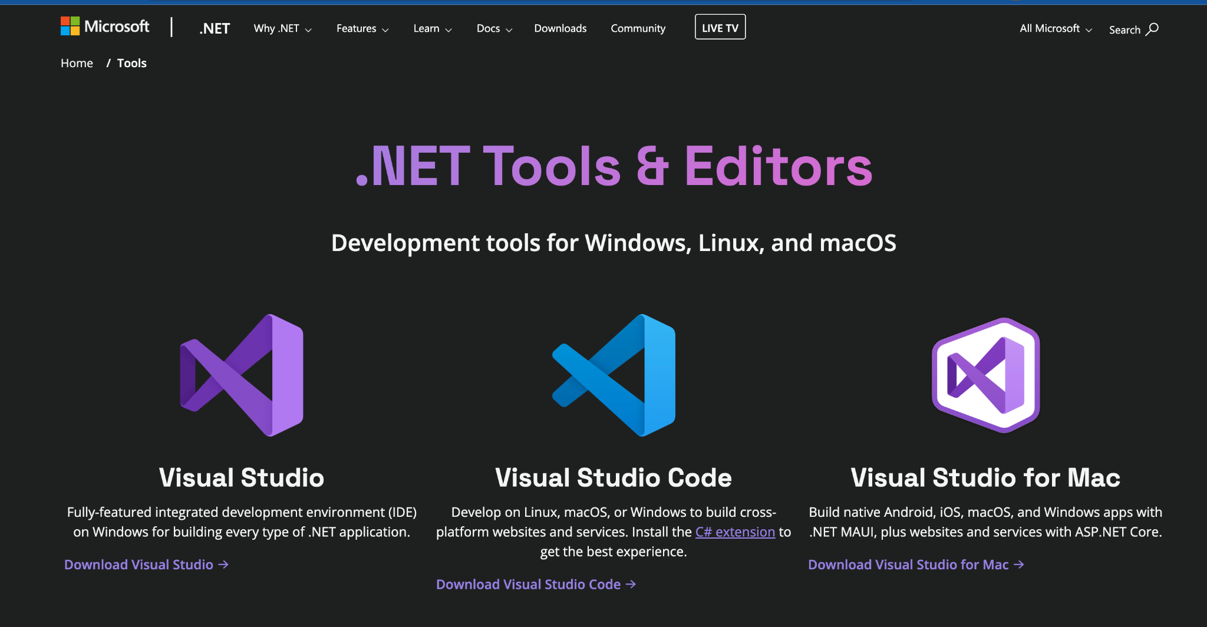
IDE for .NET

Slide 16
Hello World
In your console, make a hello directory:
mkdir hello
cd hello
dotnet new console
To execute the program:
dotnet run hello
The C# code is stored in the Program.cs file.

Slide 17
Exercise - Write your first code
Write your first line of code
Enter code into the .NET Editor
Run your first code
Observe your results
What to do if you get an error message
Display a new message
The difference between Console.Write and Console.WriteLine

Slide 18
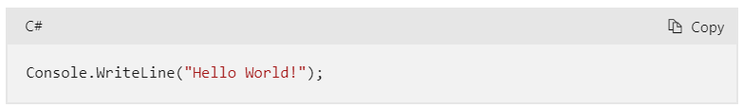
Enter code into the .NET Editor

Slide 19
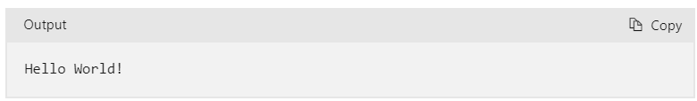
Observe your results

Slide 20
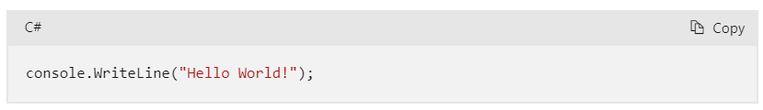
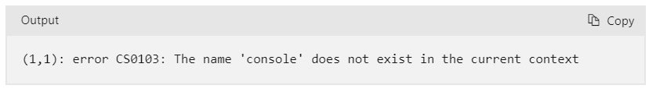
What to do if you get an error message

Slide 21
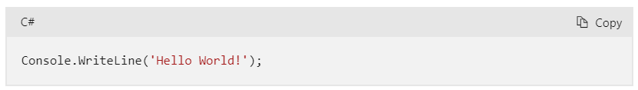
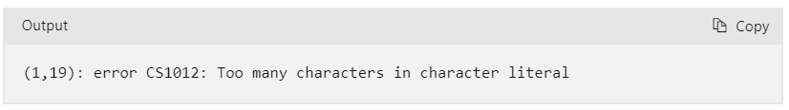
What to do if you get an error message

Slide 22
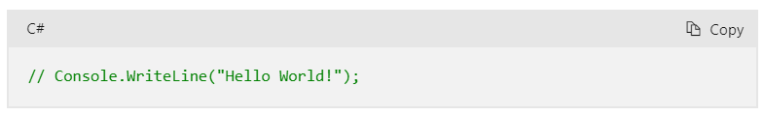
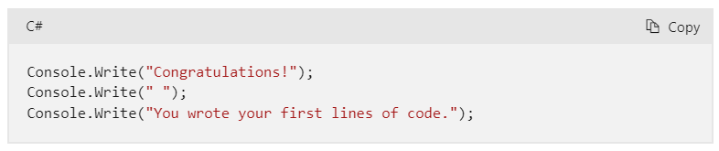
Display a new message

Slide 23
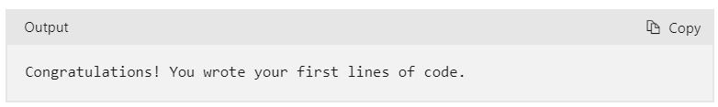
Display a new message

Slide 24
ASP.NET Tutorial - Hello World in 5 minutes
Goto the link below
https://dotnet.microsoft.com/en-us/learn/aspnet/hello-world-tutorial/intro
Follow the steps

Slide 25
Learn how it works
What is a programming language?
What is compilation?
What is syntax?
How did your code work?
Understand the flow of execution

Slide 26
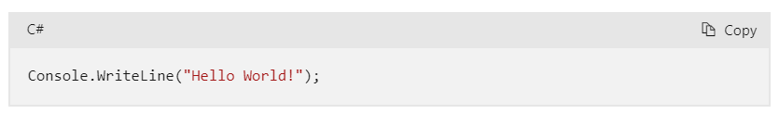
How did your code work?

Slide 27
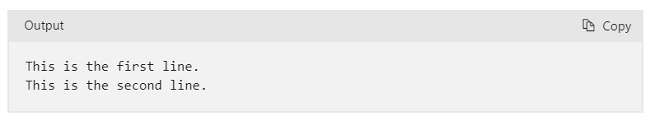
Complete the challenge
Challenge: Write code in the .NET Editor to display two messages

Slide 28
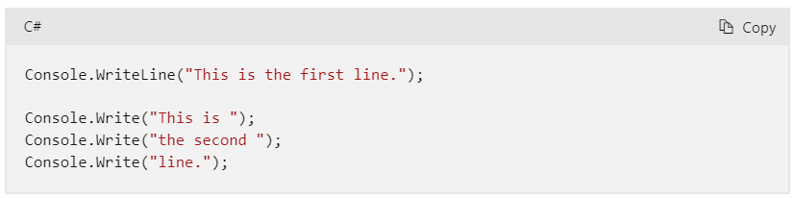
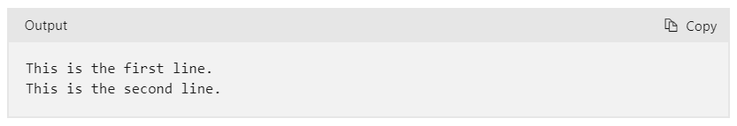
Review the solution

Slide 29
.NET Tutorial - Your First Microservice
Goto the link below
https://dotnet.microsoft.com/en-us/learn/aspnet/microservice-tutorial/intro
Follow the steps

Slide 30
Summary
Wrote basic C# code to display messages in the output console
Learned two techniques for displaying literal-string data
Gained knowledge about error identification in code
Recognized C# syntax elements like classes and methods
Understood the purpose of special symbols (operators) in C#
Initiated the journey towards building more advanced applications

Slide 31
Topic 2
Get started with web development using Visual Studio Code
Notes:
https://learn.microsoft.com/en-us/training/modules/get-started-with-web-development/

Slide 32
Objectives
Create a basic web page using HTML
Apply styles to page elements using CSS
Create themes using CSS
Add support for switching between themes using JavaScript
Inspect the website using browser developer tools

Slide 33
Prerequisites
Microsoft Visual Studio Code
Familiarity with one or more programming languages and a markup language such as HTML
A computer that's running one of the following operating systems:
  Windows: Windows 10 or 11
  Mac: macOS 10.15 or later
  Linux: Ubuntu, Debian, Red Hat, Fedora, or SUSE

Slide 34
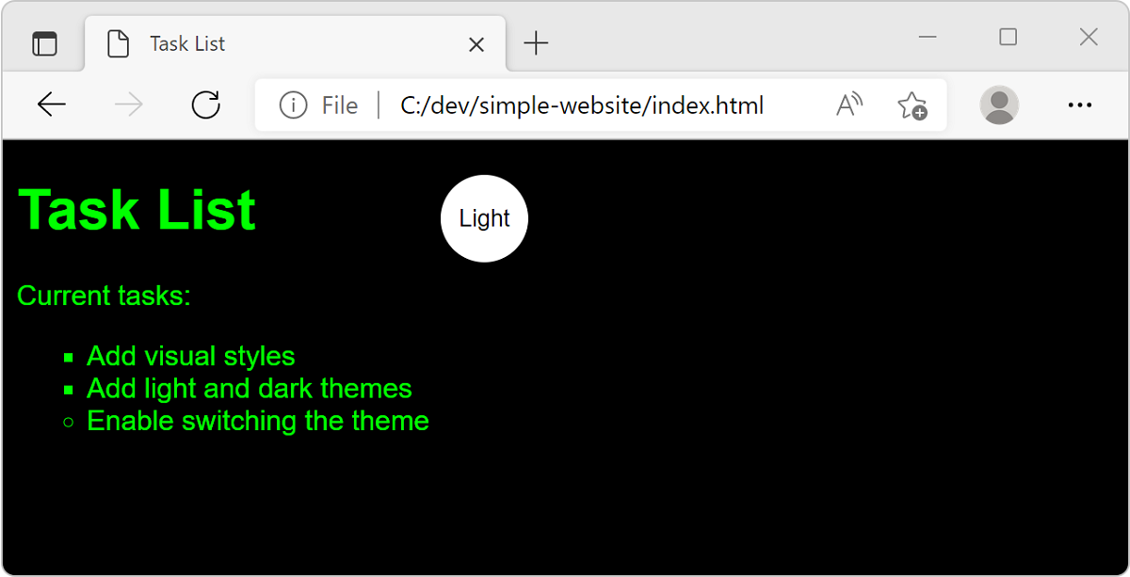
Introduction - Scenario

Slide 35
Exercise - Set up the structure of your web app
Goto
https://learn.microsoft.com/en-us/training/modules/get-started-with-web-development/2-project-structure
Follow the steps

Slide 36
Exercise - Add basic HTML to your web app
Goto
https://learn.microsoft.com/en-us/training/modules/get-started-with-web-development/3-html-basics
Follow the steps

Slide 37
Exercise - Style your HTML with CSS
Goto
https://learn.microsoft.com/en-us/training/modules/get-started-with-web-development/4-css-basics
Follow the steps

Slide 38
Exercise - Add interactivity with JavaScript
Goto
https://learn.microsoft.com/en-us/training/modules/get-started-with-web-development/5-javascript-basics
Follow the steps

Slide 39
Summary
Downloaded and installed web development tools, customized the editor, and set up a project directory with website files.
Created page elements, linked to external files, and tested the site in a browser.
Applied styles, including theme support, using CSS.
Added JavaScript for custom interaction and theme switching.
Mastered console messages for code debugging and insight.

Slide 40
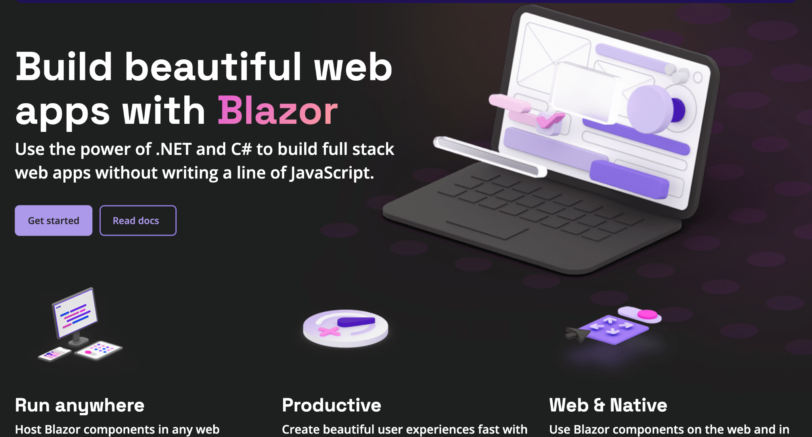
Blazor

Slide 41
Blazor Tutorial - Build your first Blazor app
Goto the link below
https://dotnet.microsoft.com/en-us/learn/aspnet/blazor-tutorial/intro
Follow the steps

Slide 42
Topic 3
Learn the basics of web accessibility
Notes:
https://learn.microsoft.com/en-us/training/modules/web-development-101-accessibility/

Slide 43
Learning Objective
Tools that users use to browse through webpages.
Tools that developers use to ensure accessibility.
Skills for ensuring that your pages are accessible.

Slide 44
Prerequisites
A browser
Basic knowledge of HTML and CSS

Slide 45
Surfing the web with more than a browser
Screen readers
Zoom

Slide 46
Ensuring accessibility with developer tools
Contrast checkers
Lighthouse
Exercise: Generate a page's Lighthouse accessibility score

Slide 47
Exercise: Generate a page's Lighthouse accessibility score
Goto the link below
https://learn.microsoft.com/en-us/training/modules/web-development-101-accessibility/3-developer-tools
Follow the steps

Slide 48
Ensuring links and images are accessible
Link text
ARIA attributes
Alt text for images

Slide 49
Link Text
"The little penguin, sometimes known as the fairy penguin, is the smallest penguin in the world.
"The little penguin, sometimes known as the fairy penguin, is the smallest penguin in the world.

Slide 50
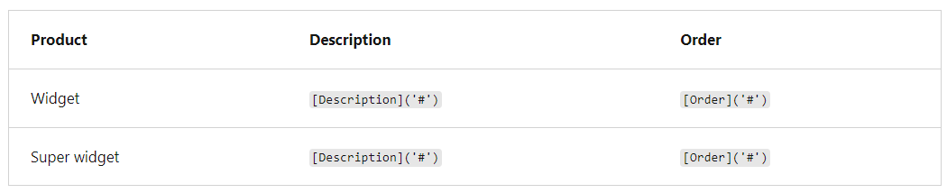
ARIA attributes

Slide 51
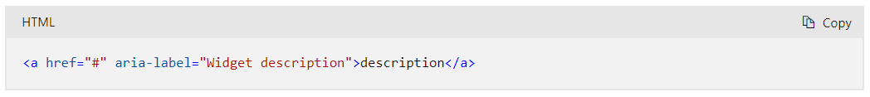
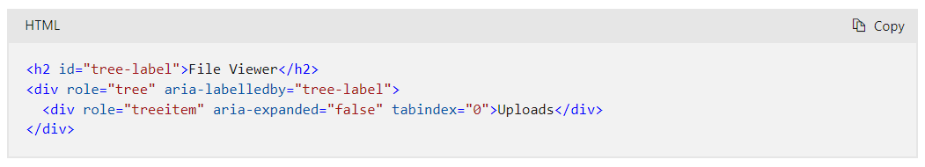
ARIA attributes

Slide 52
Designing for accessibility
Use HTML the way it was designed
Use good visual cues
Consider the keyboard

Slide 53
Topic 4
Create a web UI with ASP.NET Core
Notes:
https://learn.microsoft.com/en-us/training/modules/create-razor-pages-aspnet-core/

Slide 54
Learning Objectives
Understand when and why to use Razor Pages for your ASP.NET Core app.
Review an existing ASP.NET Core app that uses Razor Pages.
Create a new Razor Page that supports the app's product data management requirements.
Use tag helpers to reduce the context switching between HTML and C#.
Use Razor Page handlers to handle HTTP requests.

Slide 55
Prerequisites
Experience writing C# at the beginner level
Ability to write HTML at an intermediate level
Knowledge of RESTful services and HTTP action verbs

Slide 56
Introduction
Example Scenario
What will you be doing?
Required tools
  .NET SDK
  GitHub CLI
  Visual Studio Code

Slide 57
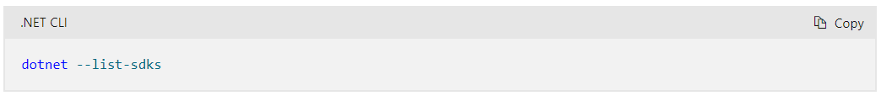
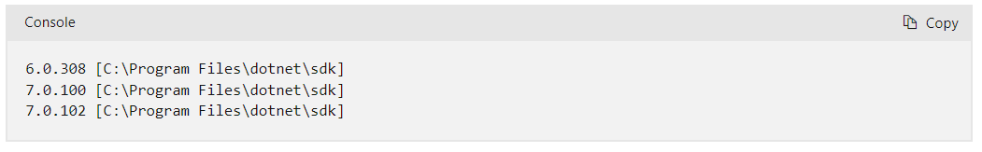
.NET SDK

Slide 58
Understand when and why to use Razor Pages
The benefits of Razor Pages
Separation of concerns
When to use Razor Pages

Slide 59
The benefits of Razor Pages
Easy setup for dynamic web apps using HTML, CSS, and C#.
Organized files by feature for easier maintenance.
Combines markup with server-side C# code using Razor syntax.

Slide 60
When to use Razor Pages
Want to generate dynamic web UI.
Prefer a page-focused approach.
Want to reduce duplication with partial views.

Slide 61
Github: Create a Razor Pages web app in Visual Studio
Goto the link below
https://github.com/dotnet-presentations/aspnetcore-for-beginners/blob/main/Tutorial/1-Create%20a%20Razor%20Page/Create-a-Razorpage-VS.md
Follow the steps

Slide 62
Exercise - Customize the project
Goto the link below
https://learn.microsoft.com/en-us/training/modules/create-razor-pages-aspnet-core/3-exercise-customize-project
Follow the steps

Slide 63
Exercise - Add a new Razor Page
Goto the link below
https://learn.microsoft.com/en-us/training/modules/create-razor-pages-aspnet-core/4-exercise-add-new-razor-page
Follow the steps

Slide 64
Understand tag helpers and page handlers
Tag helpers
  Partial Tag Helper
  Label tag helper
  Input tag helper
  Validation Summary Tag Helper
Page handlers

Slide 65
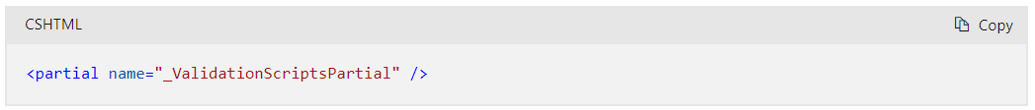
Partial Tag Helper

Slide 66
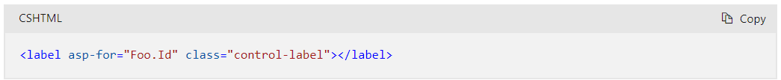
Label Tag Helper

Slide 67
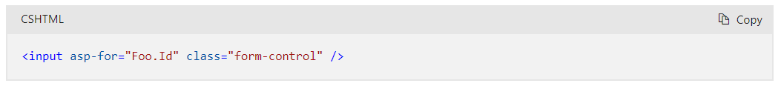
Input Tag Helper

Slide 68
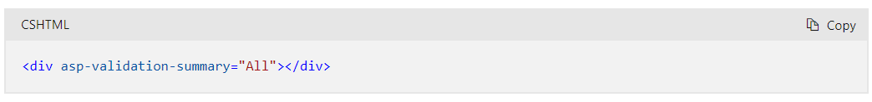
Validation Summary Tag Helper

Slide 69
Github: Add a data model in Visual Studio
Goto the link below
https://github.com/dotnet-presentations/aspnetcore-for-beginners/blob/main/Tutorial/2-Add%20a%20model/Addamodel-VS.md
Follow the steps

Slide 70
Exercise - Add new pizza form
Goto the link below
https://learn.microsoft.com/en-us/training/modules/create-razor-pages-aspnet-core/6-exercise-add-new-pizza-form
Follow the steps

Slide 71
Github: Update pages in Visual Studio
Goto the link below
https://github.com/dotnet-presentations/aspnetcore-for-beginners/blob/main/Tutorial/3-Update%20Pages/update-VS.md
Follow the steps

Slide 72
Github: Add search to a Razor page using Visual Studio
Goto the link below
https://github.com/dotnet-presentations/aspnetcore-for-beginners/blob/main/Tutorial/4-Add%20Search/SearchPage-VS.md
Follow the steps

Slide 73
Topic 5
Create a web API with ASP.NET Core controllers
Notes:
https://learn.microsoft.com/en-us/training/modules/build-web-api-aspnet-core/

Slide 74
Learning Objectives
Create a web API project with ASP.NET Core controllers.
Create an in-memory database for persisting products.
Add support for CRUD operations.
Test web API action methods from the command shell.

Slide 75
Prerequisites
Ability to write C# at the beginner level
Local installations of the .NET SDK and Visual Studio Code
C# extension for Visual Studio Code
Experience with using the command line

Slide 76
REST in ASP.NET Core
REST: A common pattern for building APIs with HTTP
Benefits of creating APIs in ASP.NET Core
Testing web APIs by using the .NET HTTP REPL

Slide 77
Exercise - Create a web API project
Goto the link below
https://learn.microsoft.com/en-us/training/modules/build-web-api-aspnet-core/3-exercise-create-web-api
Follow the steps

Slide 78
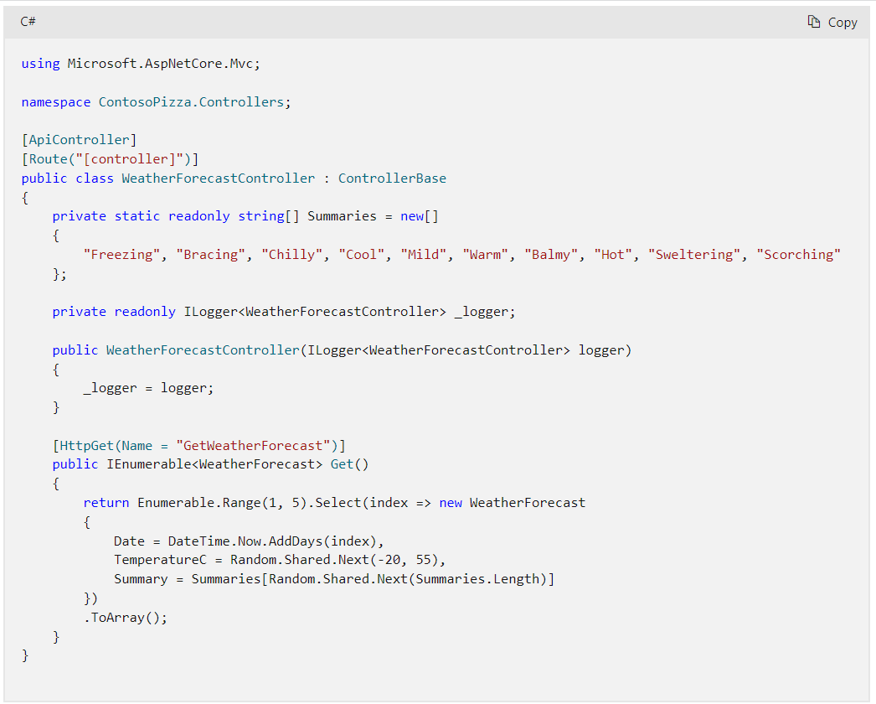
ASP.NET Core Web API Controllers

Slide 79
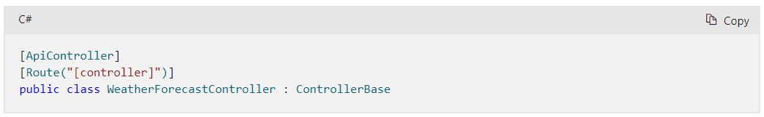
API controller class attributes

Slide 80
Exercise - Add a data store
Goto the link below
https://learn.microsoft.com/en-us/training/modules/build-web-api-aspnet-core/5-exercise-add-data-store
Follow the steps

Slide 81
Exercise - Add a controller
Goto the link below
https://learn.microsoft.com/en-us/training/modules/build-web-api-aspnet-core/6-exercise-add-controller
Follow the steps

Slide 82
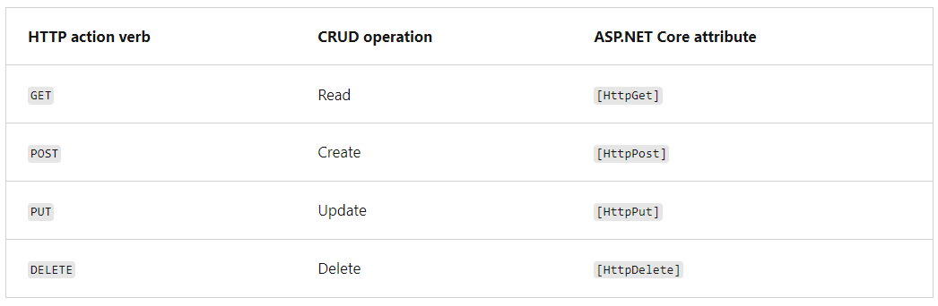
CRUD actions in ASP.NET Core

Slide 83
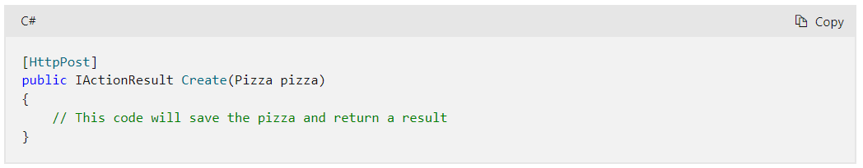
POST

Slide 84
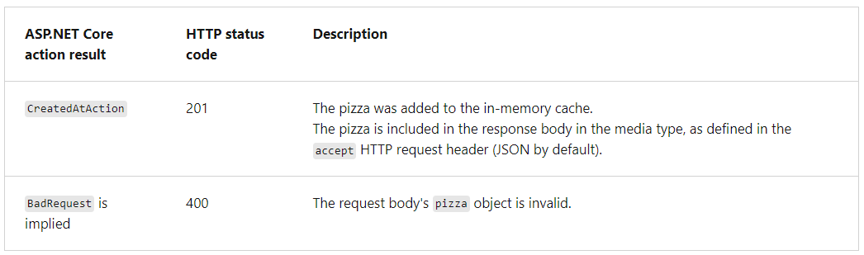
POST

Slide 85
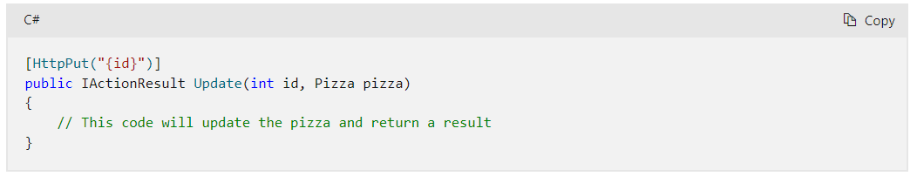
PUT

Slide 86
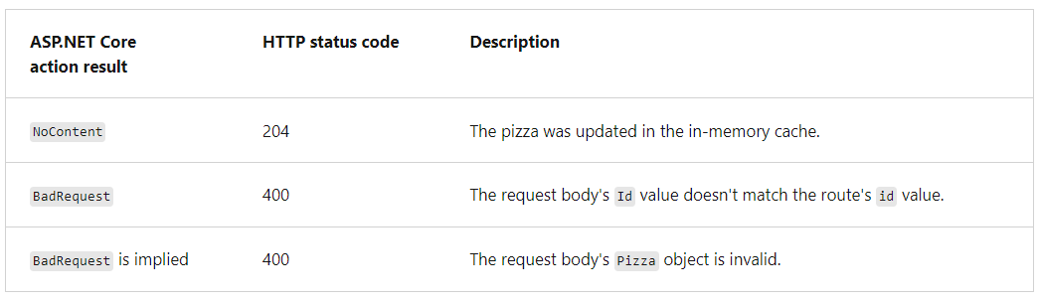
PUT

Slide 87
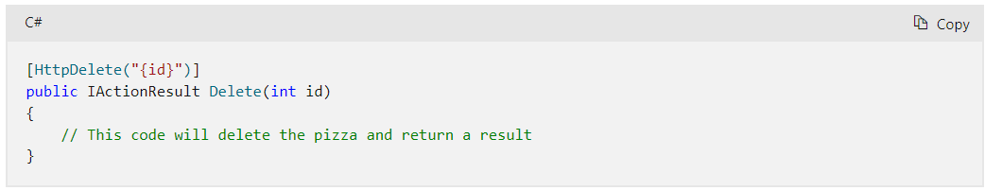
DELETE

Slide 88
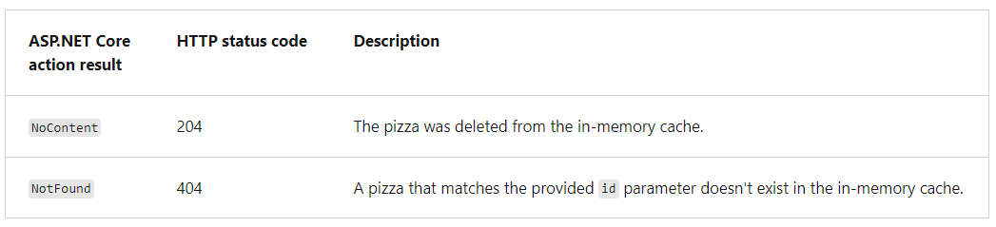
DELETE

Slide 89
Exercise - Implement CRUD operations
Goto the link below
https://learn.microsoft.com/en-us/training/modules/build-web-api-aspnet-core/8-exercise-implement-crud
Follow the steps

Slide 90
Topic 6
Publish a web app to Azure with Visual Studio
Notes:
https://learn.microsoft.com/en-us/training/modules/publish-azure-web-app-with-visual-studio/

Slide 91
Learning Objectives
Create an ASP.NET Core web app in Visual Studio
Publish a web app to Azure using Visual Studio
Update a web app in Visual Studio and publish the changes to Azure

Slide 92
Prerequisites
Knowledge of the Azure cloud environment
Familiarity with Visual Studio 2022
Familiarity with web app concepts
Basic programming knowledge
Basic HTML knowledge
A local installation of Visual Studio 2022 on Windows

Slide 93
Install the necessary workloads
Configure your Development environment
What are Visual Studio workloads?
Visual Studio workloads for ASP.NET Core development and publishing
Installing Visual Studio workloads

Slide 94
Visual Studio workloads for ASP.NET Core development and publishing
ASP.NET and web development
Azure development

Slide 95
.NET Tutorial - Deploy a microservice to Azure
Goto the link below
https://dotnet.microsoft.com/en-us/learn/aspnet/deploy-microservice-tutorial/intro
Follow the steps

Slide 96
Exercise - Create a new ASP.NET Core app
Goto the link below
https://learn.microsoft.com/en-us/training/modules/publish-azure-web-app-with-visual-studio/3-exercise-create-a-new-aspnet-app
Follow the steps

Slide 97
Explore the Azure App Service
What is the Azure App Service?
What is the App Service plan?
Select a region
Pricing and reliability levels
Specify the resource group

Slide 98
Exercise - Publish an ASP.NET app from Visual Studio
Goto the link below
https://learn.microsoft.com/en-us/training/modules/publish-azure-web-app-with-visual-studio/5-exercise-publish-an-asp.net-app-from-visual-studio
Follow the steps

Slide 99
Explore your Visual Studio App Project
Explore the project structure
Dependencies
Properties
wwwroot
Pages
Appsetting.json
Program.cs

Slide 100
Exercise - Publish an update to your site
Goto the link below
https://learn.microsoft.com/en-us/training/modules/publish-azure-web-app-with-visual-studio/7-exercise-publish-an-update-to-your-site
Follow the steps

Slide 101

Summary
Q&A

Slide 102
Thank You!

